Slide 1
CUP-FFEE

Slide 2
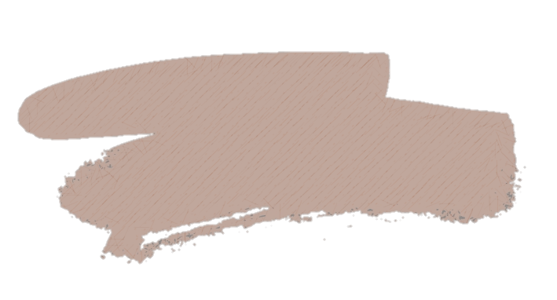
Anas El Malki
What’s CUP-FFEE
CUP-FFEE is an Ottawa-based start-up, that creates coffee cups from recycled coffee grounds.

Slide 3
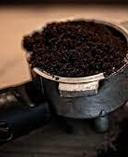
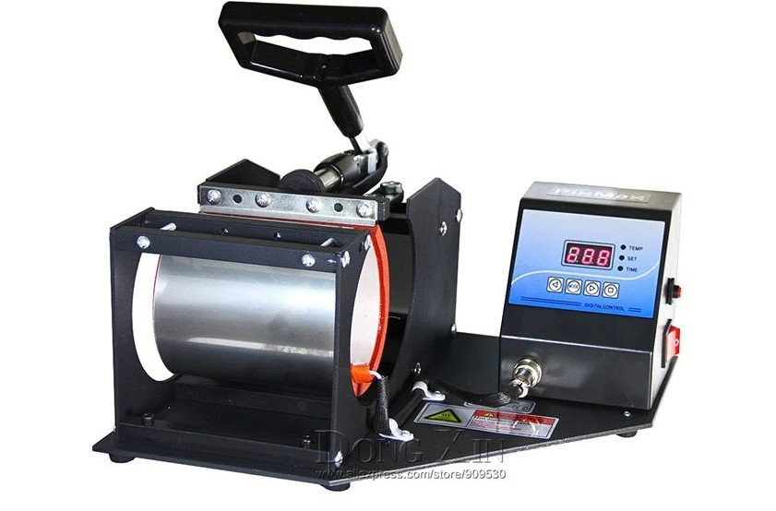
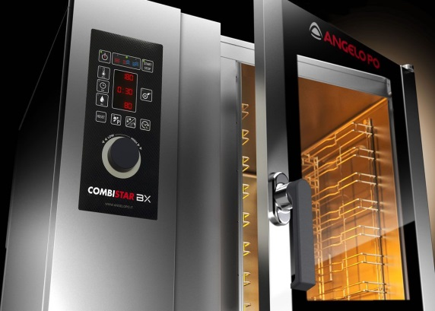
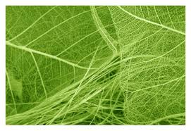
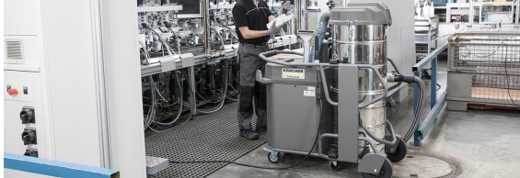
Mohamed Oussama El Malki
Product supplies
and equipment:
Coffee grounds waste
Heat press
Organic biopolymers
Ovens
Vacuums

Slide 4


Mohamed Oussama El Malki
Mission , Vision and Values :
Mission statement
Vision statement
Values to achieve our vision
Reshape consumer habits
Inspire people
Highlight :
Value of recycling
Waste streams
Creativity and innovation
Sparking the evolution

Slide 5
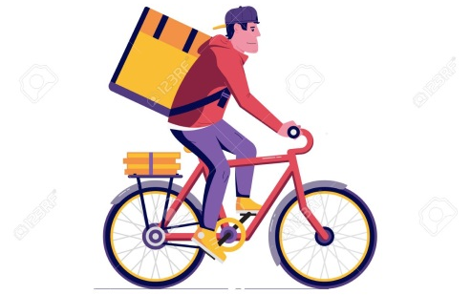
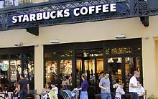
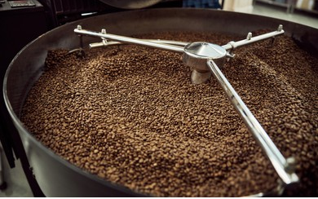
Mohamed Oussama El Malki
How we will be operating ?
Team of cyclists
Coffee shops
Workshops
Sorted and cleaned
Dried and blended

Slide 6



Mohamed Oussama El Malki
How is it going to be sold ?
Website
Courier service
Stores

Slide 7

Anas El Malki
Advantages and benefits:
Free harmful BPA plastic
Keeping your drink warm
Keeping customers healthy
The mugs can keep drinks hot for several hours
Biodegradability
The cups have the ability to decompose after interactions with biological elements

Slide 8
Market
Abderrahman bouayad
LOCAL
COFFEE SHOP
RESTAURANT
DAILY CONSUMMERS
NASCENT MARKET
DEVELOPING A UNIQUE BUISNESS
PREVENT COMPETITION

Slide 9
Taha Talha
Competition ?
Still don't have competition for this nascent market where we operate in, but if we do, competition may lower the prices.

Slide 10
Taha Talha
What stage are we in ?
Making our buisness strategy.
Testing the product.
Looking for investors.
Publishing a marketing website.
Looking for potential distributors, retailers and suppliers.
Analising the market.

Slide 11
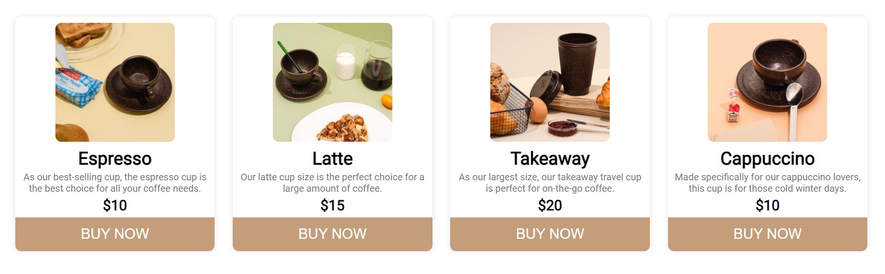
Solin Maaroof
Our marketing website

Slide 12
Solin Maaroof
Business Model
Strengths
Weaknesses
Opportunities
Threats

Slide 13
Nassym Ait Chitt
Our Team

Slide 14
We look forward to seeing you try our products, if you have any questions do not hesitate to contact us

